Slide 1

GAME PROJECT: FOOD INVADERS
script kiddiez
PowerPoint by
Hoang Anh Quan

Slide 2


INTRODUCTION
Our project is a shoot 'em up video game with top-down view named Food Invaders. The main theme of this game is a controlling a spacecraft to combat a large number of enemies by shooting at them while dodging their fire. The difficulty increases each time players advance to a new level.

Slide 3



OUR TEAM
Van Phuong Truc
3D Artist, 3D Animator,
Sound Engineer and Level Designer
Nguyen Tien Dat
Level Designer, Programmer, Concept Artist and Project Manager
Hoang Anh Quan
Concept Artist, Tester
and PowerPoint Designer

Slide 4

Aims
This game is targeted towards veteran players group, specifically devoted and dedicated audience of classic video games genre.
Food Invaders aims to be released on PC platform. If Food Invaders receives positive reception than expectation then a mobile version will be in the making.
One could consider Food Invaders to be a remake version of a classic video game title. In this version, our team not only improved the visual aspect by redesigning original graphics but also added new features and elements to gameplay department (skills tree, special effects, boss battle, etc...).
Besides we did some research and decided to chose this concept because there are a lot of classic games receive positive feedback as well make good profits.

Slide 5
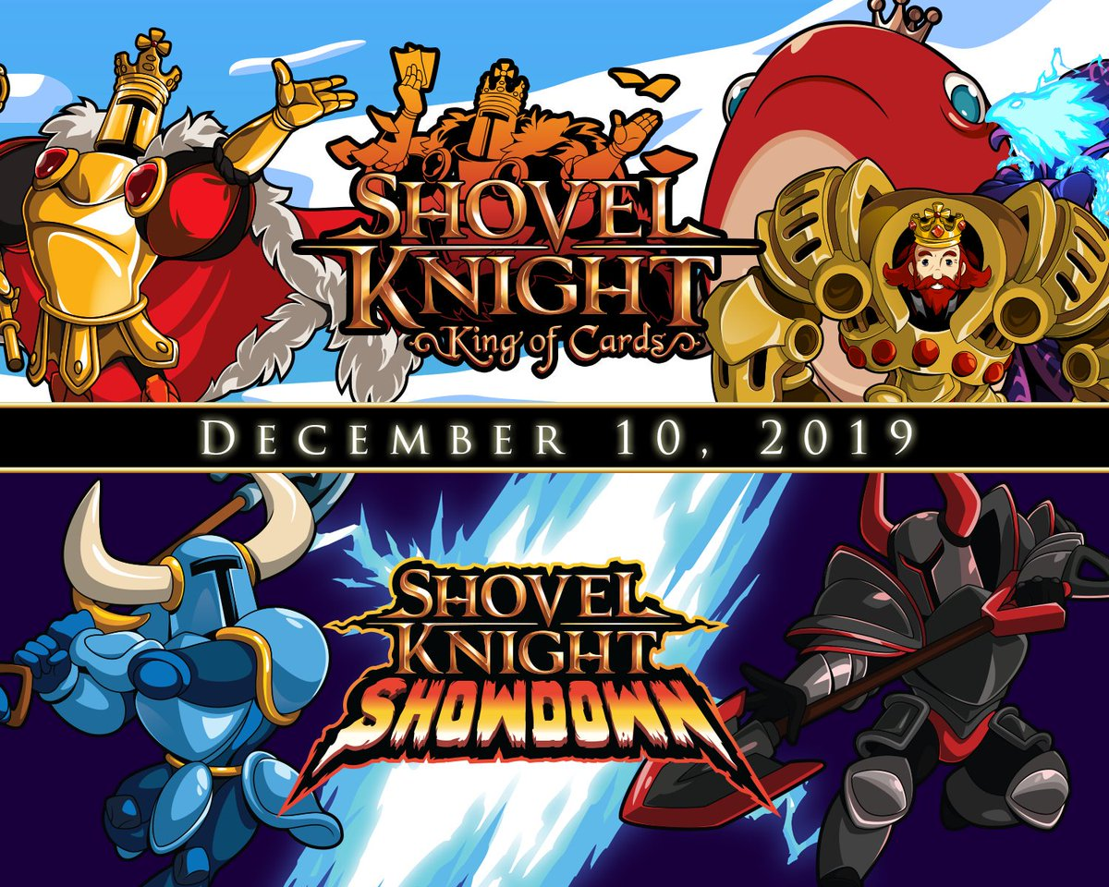

Slide 6
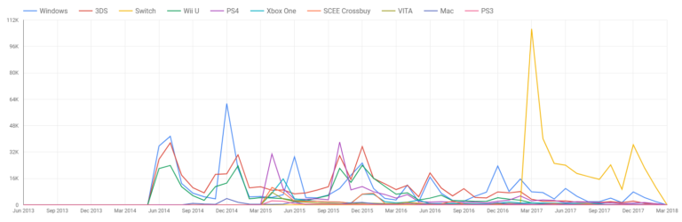
In 2017, Shovel Knight sales were 125,000 units stronger than they were in 2016 and 60% of those were from the Switch. In September 2017, Shovel Knight sales on Nintendo platforms alone
crossed over 1 million.

Slide 7
Motivations
Our game is an attempt in bringing back nostalgia and memories of video games forgotten by time.
We firmly believe with proper graphical tweaks and gameplay improvements, any potential retro games can still become strong competitors with modern-day video games.
Food Invaders is developed to be tool for training players spatial and hand-eye coordination skills, as well as vision and speed skills.
We want to create a game which can also make profits so that we can sustain our project as well as give it further development in the future.

Slide 8
SCOPE AND LIMITS
MAIN THEME
MAIN GOAL
GAME MODES
IN-GAME SKILLS
A battle between a spacecraft (player) and a technologically advanced alien race (under the forms of foods like pizza, donut, pickle, etc.) who intend on destroying the Earth
Our aim is turning this game into a “combination of the old and the new”, a balance between classic and modern.
Adventure and survival
We will also try to add some skills into the game for the player such as time manipulating, invincibility, etc. each skill can last for about 10 or 15 seconds (with some cool animation and art). Along with this, there will be some more features added to our game to make it more interesting such as customizing the spacecraft.

Slide 9

UNIQUE ASPECTS
BOSS BATTLE
CO-OP SYSTEM
CUSTOMIZATION
UPPGRADE SYSTEM
Food Invaders features different types of enemies (each has its own weapon, moving pattern, etc...). At the end of every level, there is a boss for player to defeat to completely clear it. Player can obtain the defeated bosses’ abilities.
Food Invaders’s cooperative gameplay allows additional players (maximum is 4) and increasing the difficulty level to compensate for the additional players. Players can join servers via local area networks to play together.
Players have the freedom to customize character according to their likings with a variety of skins.
Power-ups are available for players to upgrade their weapons. Players are able to modify their character's abilities and let it grow in a multitude of ways (different weapons, skills) as the game progresses.

Slide 10
ADVENTURE MODE
SURVIVAL MODE
In adventure mode, there will have 150 waves in 10 levels across 15 planets, at the end of each chapter (planet) will have a boss which must be defeated in order to get to a new planet. Normal enemy will be flying around and shooting things (for example, pizza will shoot pepperoni), we will try to make different flying patterns so that the game won’t get tedious, we will also try to create some types of enemy that carrying gadget and slightly smarter than the rest, if possible.
There will be a special feature in survival mode, the capability of the spacecraft to face in any direction (it can only face up in adventure mode). The gameplay will be endless, difficulty will increase each time player get to a new chapter: enemy will fly and shooting faster.

Slide 11
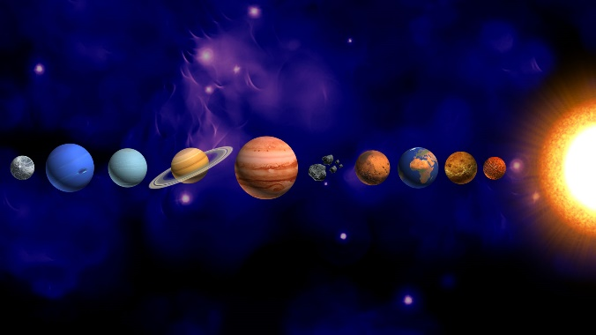

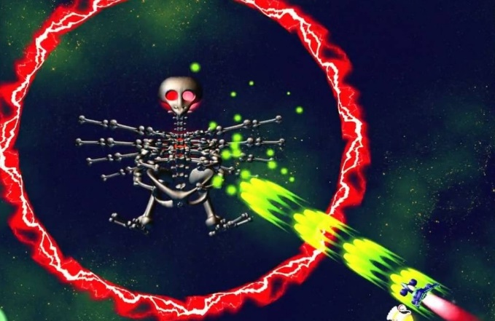

GRAPHIC PROTOTYPES
This game will have several different types of ammo that resemble boxes with the ammo’s logo on it, these boxes will be drop randomly while fighting with enemy. Player can upgrade their ammo by eating these boxes or the “power up”- might look like this:

Slide 12
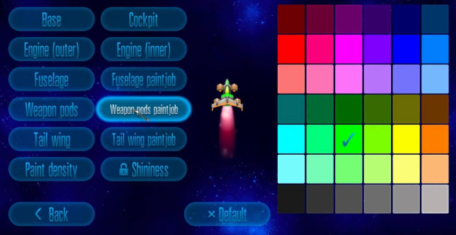
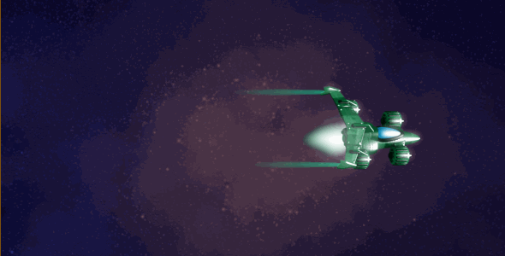
GRAPHIC PROTOTYPES
We will also try to add some skills into the game for the player such as time manipulating, invincibility, etc. each skill can last for about 10 or 15 seconds (with some cool animation and art). Along with this, there will be some more features added to our game to make it more interesting such as customizing the spacecraft.

Slide 13
RISKS
TECHNICAL RISK
DESIGN RISK
The aspects of technical risk are things like rendering engines, path finding, etc. In game, technical risk also fluctuates wildly with the addition of new game mechanics.
Risk of not including the right features that create a potent value proposition for your target audience.
QUALITY RISK
SCOPE RISK
Risk of errors. A product that solves all other factors, but includes bugs and other malfunctions.
Risk of not doing enough or doing too much.

Slide 14
MAIN GOAL
Our aim is to make a classic game just like old times, however, we still make something new so that our game can be more unique and interesting. The game can be described as “a combination of the old and the new”, a balance between classic and modern, and what is modern about this game is those mentioned features we are planning to add into our game in the near future.

Slide 15


